Slide 1
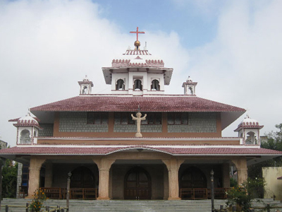
Update from Udaipur Diocese
Laudato si: A means for the realisation of questions related to Integral Ecology
Bishop Dev Prasad Ganava
Fr George C M (VG)
Viren Lobo

Slide 2
Main principles of Laudato Si
A Cry to save Mother Earth (our sister)
Sin means distance from God, neighbour and nature
Call to restore broken community ties
http://ielaind.org/wp-content/uploads/2021/01/A-Call-for-restoration-of-broken-societal-threads-as-a-precondition-for-ecological-democracy.pdf

Slide 3
Seven plays caturing the essence of Laudato si
During COVID 19, a series of seven plays were written placing different aspects of the issues related to establishment of ecological democracy at the local level. These have been published in two volumes, url given below
http://ielaind.org/wp-content/uploads/2021/01/A-Tryst-with-Mother-Nature-and-the-Beast-within.pdf
http://ielaind.org/wp-content/uploads/2021/01/Think-Globally-Act-Locally-The-Family-within-the-world-without.pdf

Slide 4
An overview of the SDGs
A set of slides outlining the essence of each SDG
http://ielaind.org/internship-by-anjali-dcunha/

Slide 5
Programme with schools
http://ielaind.org/wp-content/uploads/2017/05/Operationalising-the-plan-of-action-for-development-of-of-Childrens-parlaiments-around-the-SDGs-by-SMA_Fatehpura-and-IELA_Udaipur.pdf
http://ielaind.org/wp-content/uploads/2017/05/The-Wetlands-of-Menar-beckon.pdf
Participation of St Mary’s of the Angels, Fatehpura and St. Anthony’s school in Pragrati Media Shala a workshop to explain the use of a tool kit for children to understand the environment.
Installation of solar panels in schools of Banswara, Udaipur, Chittaurgarh, Kankroli and Bhilwara and solar pumpset at Gogunda

Slide 6
Other Programmes
http://ielaind.org/wp-content/uploads/2017/05/Report-of-World-Wetland-Day2024_IELA-Partners_FINAL-compressed.pdf
http://ielaind.org/wp-content/uploads/2017/05/Ecosystems-approach-to-land-use-ecology-and-livelihoods-in-Rajasthan_A-policy-brief.pdf
https://www.youtube.com/watch?v=vKxLG3HwDCk

Slide 7
Needs identified
Considering majority of tribals in the diocese, need to integrate questions related to tribal upliftment with integral ecology questions
Building on the momentum of developing close community ties to incorporate integral ecology questions can tribals provide the lead ?

