Slide 1
Political Economy of Agriculture
Conceptual Ideation
Depinder Singh Kapur
Presented at a lecture on Political Economy at Shiv Nadar University

Slide 2
What is a Political Economy Framework
“Political economy uses methods from economics, sociology and political science to understand how a country or a specific programme is managed and performs, and to understand the relationships between economic processes, political policies, and social institutions”
ODI, 2005
“Political economy is an interdisciplinary branch of the social sciences that focuses on the interrelationships among individuals, governments, and public policy”

Slide 3
Political economy, branch of social science that studies the relationships between individuals and society and between markets and the state, using a diverse set of tools and methods drawn largely from economics, political science, and sociology. The term political economy is derived from the Greek polis, meaning “city” or “state,” and oikonomos, meaning “one who manages a household or estate.” Political economy thus can be understood as the study of how a country—the public’s household—is managed or governed, taking into account both political and economic factors.
Brittannica

Slide 4
What is a political economy framework of analysis?
Can we separate what is economic and what is political - in the development of a nation or of any sub system – agriculture, industry, culture, sport?
Is economic only about demand and supply, determining the price of commodities?
Or is it about understanding how production and pricing can be done to ensure maximum reach and welfare of the people.
Is politics only a study of the constitution and laws, government formation, elections, political parties and structures and institutions of the state – judiciary, executive and legislature?
Or is it about contestation for power that is expressed through political institutions both formal and informal?
Can economics and politics be separated – in any filed of study. Whether Social(caste, gender, backwardness, etc), a Production process(small, medium and large industry, infrastructure, service sector or agriculture) or economic development(of a nation or a region/state)?
Why people are uncomfortable in combining politics and economics?

Slide 5
Why a hesitation of combining political science and economics?
Because it appears as two distinct disciplines. Experts do not make the inter connections and it is taught so in schools and universities.
Requires relating a set of Values/Norms/Desired outcomes( that is political) with analysis of economy and its trends, while studying society and development
Requires a historical approach of study

Slide 6
Global price - Wheat

Slide 7
Global price - Rice

Slide 8
Political Economy Framework - key considerations
Historical, current and future development pathway of a nation or any sub system of agriculture, industry or society
What exists today is not the end of the world
Economic Development is itself a political process. You cannot change economic policies without political backing
Economics and politics were never separate. The separation of politics and economic, as two distinct fields, occurred after the Classical Economists Adam Smith, Ricardo and Marx.
An understanding of what constitutes national politics - What constitutes the state. What is political power, is it just electoral or is it based on economic power? Where is the contestation happening within this system – within the existing power relations and those who are opposing the system
Integrating all factors. Identifying the primacy of political or economic factors. Not negating the environmental, cultural and psychological factors.

Slide 9
PE Framework
Understanding the historical trend of change : growth/decline
Identifying the enabling factors for this change – technological, economic, institutional, political
Identifying the predominant factor/variable for the change
Identifying the key actors and the roles they played. Understanding the context in which they succeeded or failed
How did the change impact different sections of society. Was there any duality or dichotomy of impact – social, environmental, economic, political.
What is the next level of contradiction/dichotomy that is emerging, what are the next level of economic, social and environmental challenges, key political forces/actors and their political base.

Slide 10
Political Analysis

Slide 13
What Is Political Economy?
Adam Smith, David Ricardo, and John Stuart Mill are widely regarded as the originators of modern economics. But they called themselves political economists, and Mill’s Principles of Political Economy was the fundamental text of the discipline from its publication in 1848 until the end of the century. These early theorists could not conceive of the economic and political worlds as separate.
IMF
https://www.imf.org/external/pubs/ft/fandd/2020/06/political-economy-of-economic-policy-jeff-frieden.htm

Slide 14
What is Classical Economics
Classical economics or classical political economy : was represented by political economists – Adam Smith, Jean-Baptiste Say, David Ricardo, JS Mill and Robert Malthus.
Emerging in the late 18th century at the advent of industrial revolution in England. Tried to explain how the national economic growth takes place through the efficient division of labour, without regulation from the King or Feudal power.
Adam Smith’s work on “An Enquiry into the Nature and Causes of the Wealth of Nations”, 1776 explained the origin of the wealth of a nation describes in five chapters:
Causes of improvement of productive powers of labour and how benefits and natural distributed among all. Principle of Division of Labour.
Capital stock and its role in allocation of quantities of labour
Policies favouring development of industry and agriculture
Theories of political economy that the sovereign rulers
Revenue and expenditures of the state/sovereign rulers. Expenses of rulers that are justified. Understanding of causes of sovereign debt and its impact on the nation.

Slide 15
Market - as the invisible hand of god
The Invisible Hand is a concept that describes the unintended greater social benefits and public good brought about by individuals acting in their own self-interests. First introduced by Adam Smith in his work “ Theory of Moral Sentiments”, 1759.
Akin to invoking “divine providence” as the hand of god, that somehow makes the markets function for benefit of all.

Slide 16
“As every individual, therefore, endeavours as much as he can both to employ his capital in the support of domestic industry, and so to direct that industry that its produce may be of the greatest value, every individual necessarily labours to render the annual revenue of the society as great as he can. He generally, indeed, neither intends to promote the public interest, nor knows how much he is promoting it. By preferring the support of domestic to that of foreign industry, he intends only his own security; and by directing that industry in such a manner as its produce may be of the greatest value, he intends only his own gain, and he is in this, as in many other cases, led by an invisible hand to promote an end which was no part of his intention. Nor is it always the worse for the society that it was not part of it. By pursuing his own interest he frequently promotes that of the society more effectually than when he really intends to promote it.”

Slide 17
What is Neo Classical Economics
Neoclassical economics is a broad theory that focuses on supply and demand as the driving forces behind the production, pricing, and consumption of goods and services. It emerged in around 1900 to compete with the earlier theories of classical economics.
One of the key early assumptions of neoclassical economics is that utility to consumers, not the cost of production, is the most important factor in determining the value of a product or service. This approach was developed in the late 19th century based on books by William Stanley Jevons, Carl Menger, and Léon Walras.

Slide 19
History of economic thought
...the history of economic thought about ecosystems/nature..(E. Gomez-Bagethun etal 2009; Fig 1)

Slide 20
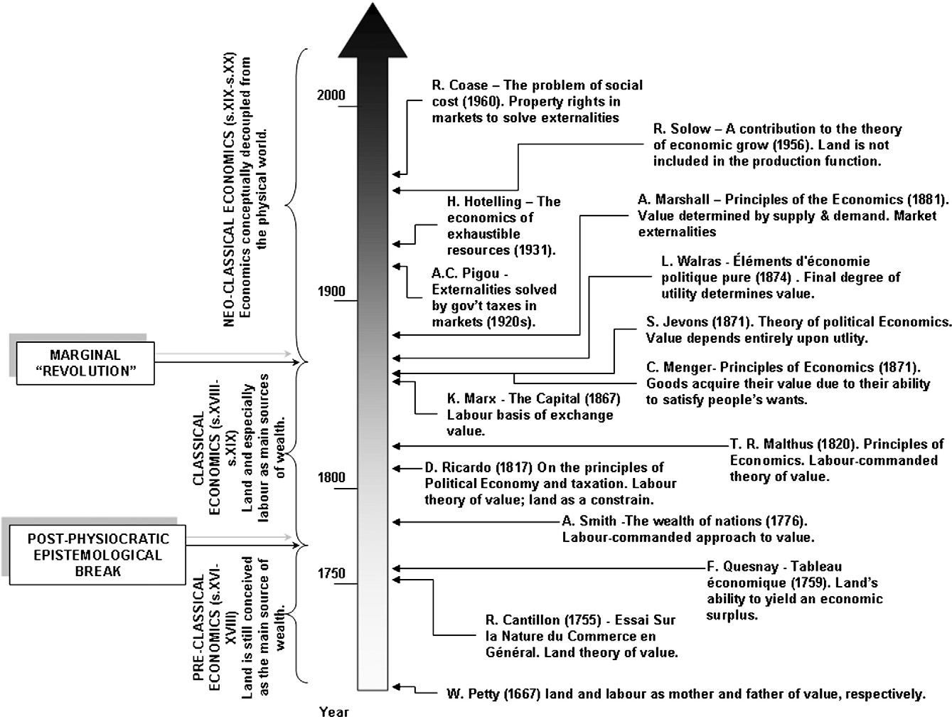

Slide 21
Shift from Classical to Neo-classical economics
- a slow move of the primary focus on land and labour towards the factors (of production) labour and capital
- a move from physical to monetary analysis
- a move from use values to exchange values

Slide 22
Critique of Political Economy - Marx
Demystifying the “invisible hand”. Explained the working of the new political economy without the need to look for moralistic justification for its working – “self interest of individual leads to societal benefit”, “theories and fair revenues of sovereign rulers”.
“ The consciousness of men depends on their existence, and not the other way around”
Advances Adam Smith contribution to Political Economy : that it is Labour that creates “value”. To the understanding of emergence of “Commodities” and “Capital” thus created in a large market economy where many commodities are now brought and sold as “Exchange Value” vs. “Use Value”.
That now provide the basis for a new social consciousness in terms of human values and thinking that is very different from the feudal era. That just like physical world/sciences, the social and economic phenomena are also law governed, can be mediated and is not god ordained.
On the new economic structure of capitalism – a new social consciousness and new values, provide the basis for new legal and political structures and governance to replace the feudal era.
The changed material conditions and consciousness, also provide the basis of change from capitalism.

Slide 23
Political Economy of Agriculture and Water

Slide 24
Political Economy context
What was the economics in non market societies in ancient civilizations, in tribal communities and remote rural communities?
What was the basis of barter and exchange ?
What was the contribution of agriculture in development of industry?
What does producing for the market mean?
Why price of agriculture commodities is relatively stagnant?
Why terms of trade do not favor agriculture today?

Slide 25
Agrarian Development – Historical context
Agriculture production or livestock wealth increase and a surplus – releases people form the work of agriculture and livestock rearing. The jajmani system in India where allied agriculture systems – blacksmith, carpenter, leather workers, potters – emerged.
Emergence of local chiefs and kings – who impose tax on farm produce and also engage in plunder and forced labour to establish their kingdoms.
As kings and dynasties become strong, cities start forming – first around port towns and then others. Cities further diversify labour and the invention of engineering and technologies of metallurgy, glass, ship building, architecture and monuments.
These advancements also support expansion and intensification of agriculture.
Large feudal kingdoms and emergence of a trading and money lending class – give birth to capital as a means of production – create the basis for the capitalist class to emerge and undertake the industrial revolution – finally an overthrow of feudal rule itself.
Livestock-agriculture linkage strengthened – livestock primarily for draught power, not for milk.

Slide 26
How critical is surplus agriculture production
Agriculture production
subsistence food consumption by farmers + surplus food

Slide 27
Simplified pathway – contribution of agriculture surplus
Surplus food production
Division of Labour, village level to city level crafts
Development of Industry shipping, trade. In turn develop agriculture
Feudal kings want to usurp this surplus
Capitalist revolutions diminish the power of the kings
Finance capital and agri business

Slide 28
Economic Development under Capitalism(1800-1950)
Cash cropping – as colonial focus in 1800-1930. Rubber, Jute, Cotton, coffee, Tea, Timber – Trees more than food crops
Emergence of large scale industry and manufacturing(cotton textile, machinery, mining, railways and transport, steel industry, roads, ship building, motor industry)
Global markets for raw material and sale of manufactured goods
Destruction of small manufacturing
Emergence of Finance Capital – investment for profits
World wars for markets and raw material

Slide 29
Farming under capitalism depends on :
Irrigation and electricity/power supply infrastructure
Farm machinery
Seeds, Fertilizers and Pesticides
Market price assurance and timely procurement
Godowns and storage
Processing and Value Add
Transportation
Storage infrastructure of Mandis
Distribution and sale to consumers, exports and to other industry(including now bio fuel)
Capital and credit for investments, variable cost including labour payments

Slide 30
Normative issues of Indian Agriculture today
Steady decline in water tables
At least 60% of India’s districts are either facing a problem of over-exploitation or severe contamination of groundwater (Vijayshankar et al 2011).
Evidence of fluoride, arsenic, mercury, and even uranium and manganese in groundwater in some areas
Increasing levels of nitrates and pesticide pollutants in ground water
Declining productivity
Average crop response to fertiliser use has fallen from around 25 kg grain/kg of nitrogen, phosphorus and potassium (NPK) fertiliser during the 1960s to 6 kg grain/kg NPK by 2010
India ranked 94th out of 107 countries on Global Hunger Index in 2020
Despite overflowing stocks of foodgrain
Rising input costs and declining margins
Food/Nutrition imbalance – wheat-rice cropping patterns and health implications
Loss of bio diversity

Slide 31
Global price - Wheat

Slide 32
Global price - Rice

Slide 33
Political Economy perspective of Agriculture
Historical context to situation today and likely future
From state investment and annual support to private investment and markets
To produce current levels – unsustainable(economically and environmentally), requires more state investment
Farmers incomes are not rising
From Input to Output – capital investment dependent
Labour and other inputs are also dependent on financing
Credit and Financing as the most critical factor
National to International stage. Finance Capital and its impact on agriculture.
Currency stabilization priority and its impact on agriculture and commodity prices in less developed countries
Nation needs a buffer stock of grains but is constrained by the imperative of controlling subsidies and fiscal deficit
Secular decline in agriculture prices
Consolidation of agri-business
Input to Output level consolidation of agri business
Farm laws : allow contract farming at scale, removal of restrictions on storage, administrative resolution of disputes between companies and farmers.
Implications on cropping, environment, farm incomes. Likely to become better?

